Slide 1

REACT

Slide 2
What is REACT?
React is an open source JavaScript library that helps you create user interfaces easily. It is focused on visualization and has a very efficient algorithm to identify the differences between the virtual representation of the current page and the new one. Based on those differences, it makes the necessary changes to the Document Object Model (DOM) in a very dynamic way.
Using React, you get HTML with all the functionality of JavaScript and additionally the centralized CSS graphic style and ready to be used in any of your projects.

Slide 3
Why use React?
In web design, it is essential to create a user interface that favors the transmission of information, navigability and interaction. React is an excellent option to create all kinds of web applications or even applications for mobile devices.
It was initially developed by Facebook but the advantage is that it is free software. And since its introduction in the market, it has gained much popularity.
It was created to make the development of the components of the user interfaces easier and its main requirement was to offer a higher performance than the other alternatives on the market.

Slide 4
Why use React? (2)
You can design simple views for each state in the application and React takes care of efficiently updating and rendering the components when the data changes.
What React is looking for is the development of applications in a more agile way. When you use pure JavaScript or other libraries such as jQuery, there is an approach to manipulating the Document Object Model that includes the need to be making continuous changes that can be more difficult and require more development time.

Slide 5
REACT vs other librarles.
React creates an association between views and data, so there is no need to write code to manipulate the page when changes are made to the data. In simple libraries like jQuery, changing data is a laborious task and in React it is done automatically.
React also has the benefit of encapsulating the code in components, offering more important advantages than plugins, such as the interaction between them.
Compared to frameworks like Angular or Ember, React doesn't include all of its components. (React is a library and not a framework) so it takes care of the user interfaces. However, it reaches more or less the same functionalities and can undoubtedly serve as an alternative.

Slide 6
REACT vs other librarles (2)
React has a quite varied ecosystem of tools, applications and libraries. Some of the tools used are Redux or Flux, which deal with the flow of data clearly in the applications. The developer can choose between different frameworks for the flow of data. Other examples include application generators, customer routing systems, among others.
React works based on reusable components, which means that you can use the development of one project in another, in this way, a large part of the community shares its components and allows anyone to use them.

Slide 7
Virtual DOM in React
Rather than focus on "data-binding", as most alternative libraries do, React emphasizes the need to update views when required by the developer, and achieves this through the Virtual DOM.
The Virtual DOM is one of the main features of React. This concept refers to a representation of the DOM but in memory, used to increase the performance of the components and applications with which the user interacts directly. This offers a better user experience and better fluidity.
What the Virtual DOM does is to selectively elaborate sub-trees of the nodes on the basis of state variations, achieving the least manipulation of the DOM possible, to keep the components updated and the data structured.

Slide 8
React in the technology industry market
The 2020 StackOverflow survey revealed that React is the favorite framework for developers. This is because JavaScript is still the most popular programming language today.
Large technology companies, such as: Tesla, Netflix, WhatsApp, PayPal, Uber, etc. They have chosen REACT.

Slide 9
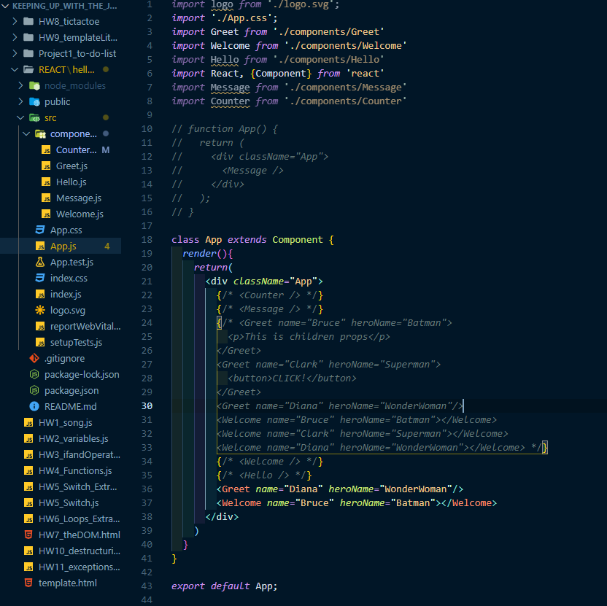
REACT Code snippet (1)

Slide 10
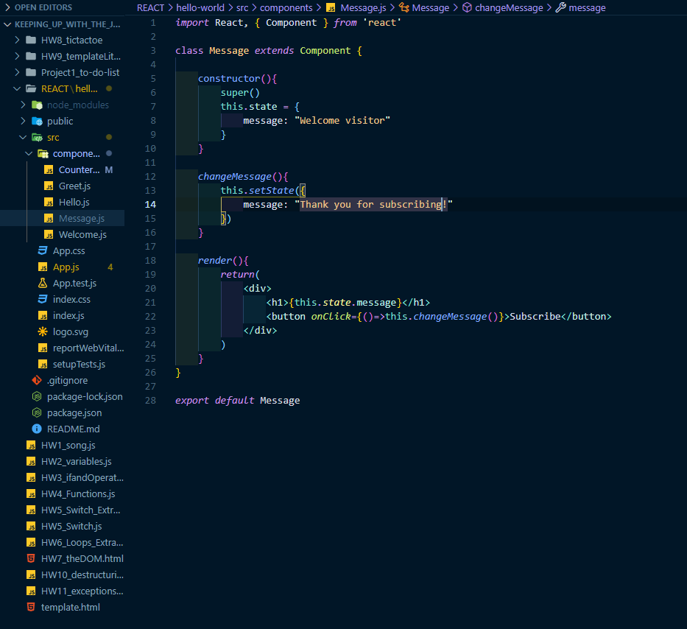
REACT Code snippet (2)

Slide 11
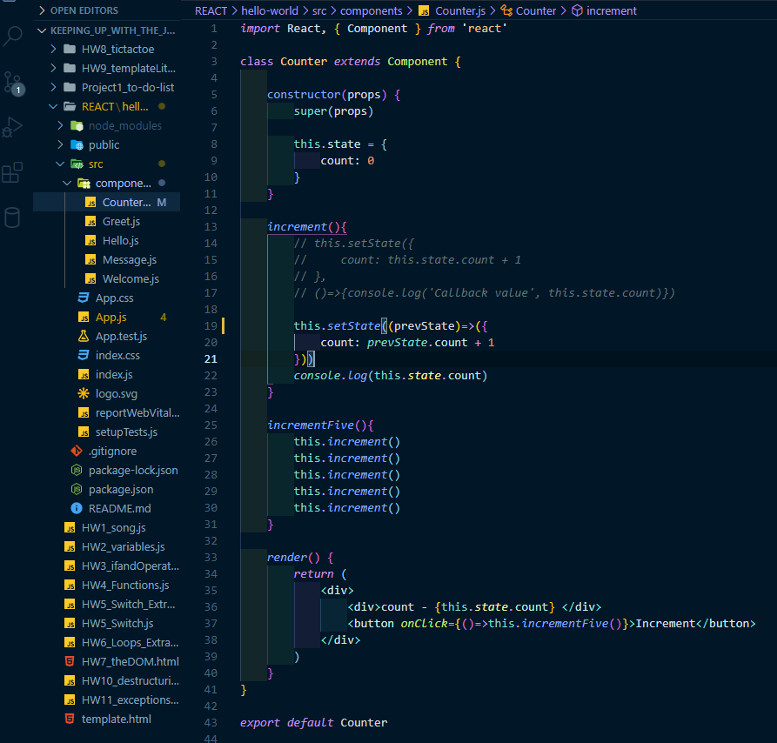
REACT Code snippet (3)

